Slide 1
AHOD 2131 RT Guidelines including sample cases
Sarah Milgrom, MD
Andrea Lo, MD
Ray Mailhot-Vega, MD
Brad Hoppe, MD
Notes:
IND#117117

Slide 2
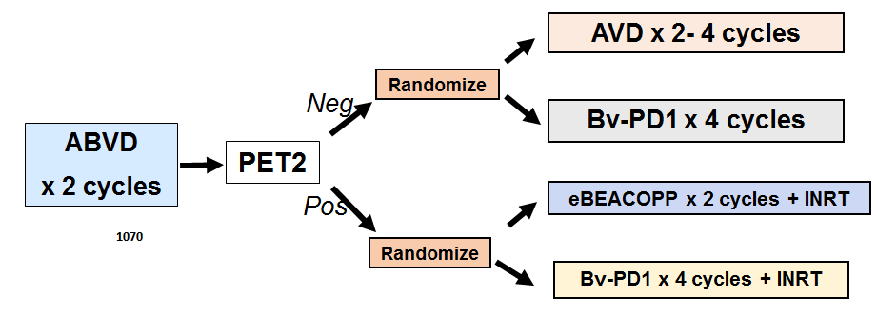
AHOD2131 Radiation Approach: Patient Selection
5-60 y/o
Stage I-II cHL
85%
15%
ISRT
ISRT
RT is used for SERs only
RT is used for SERs due to their higher relapse risk
Anticipated to comprise ~15% of the total cohort
For comparison, on AHOD0031: ~75% received RT

Slide 3
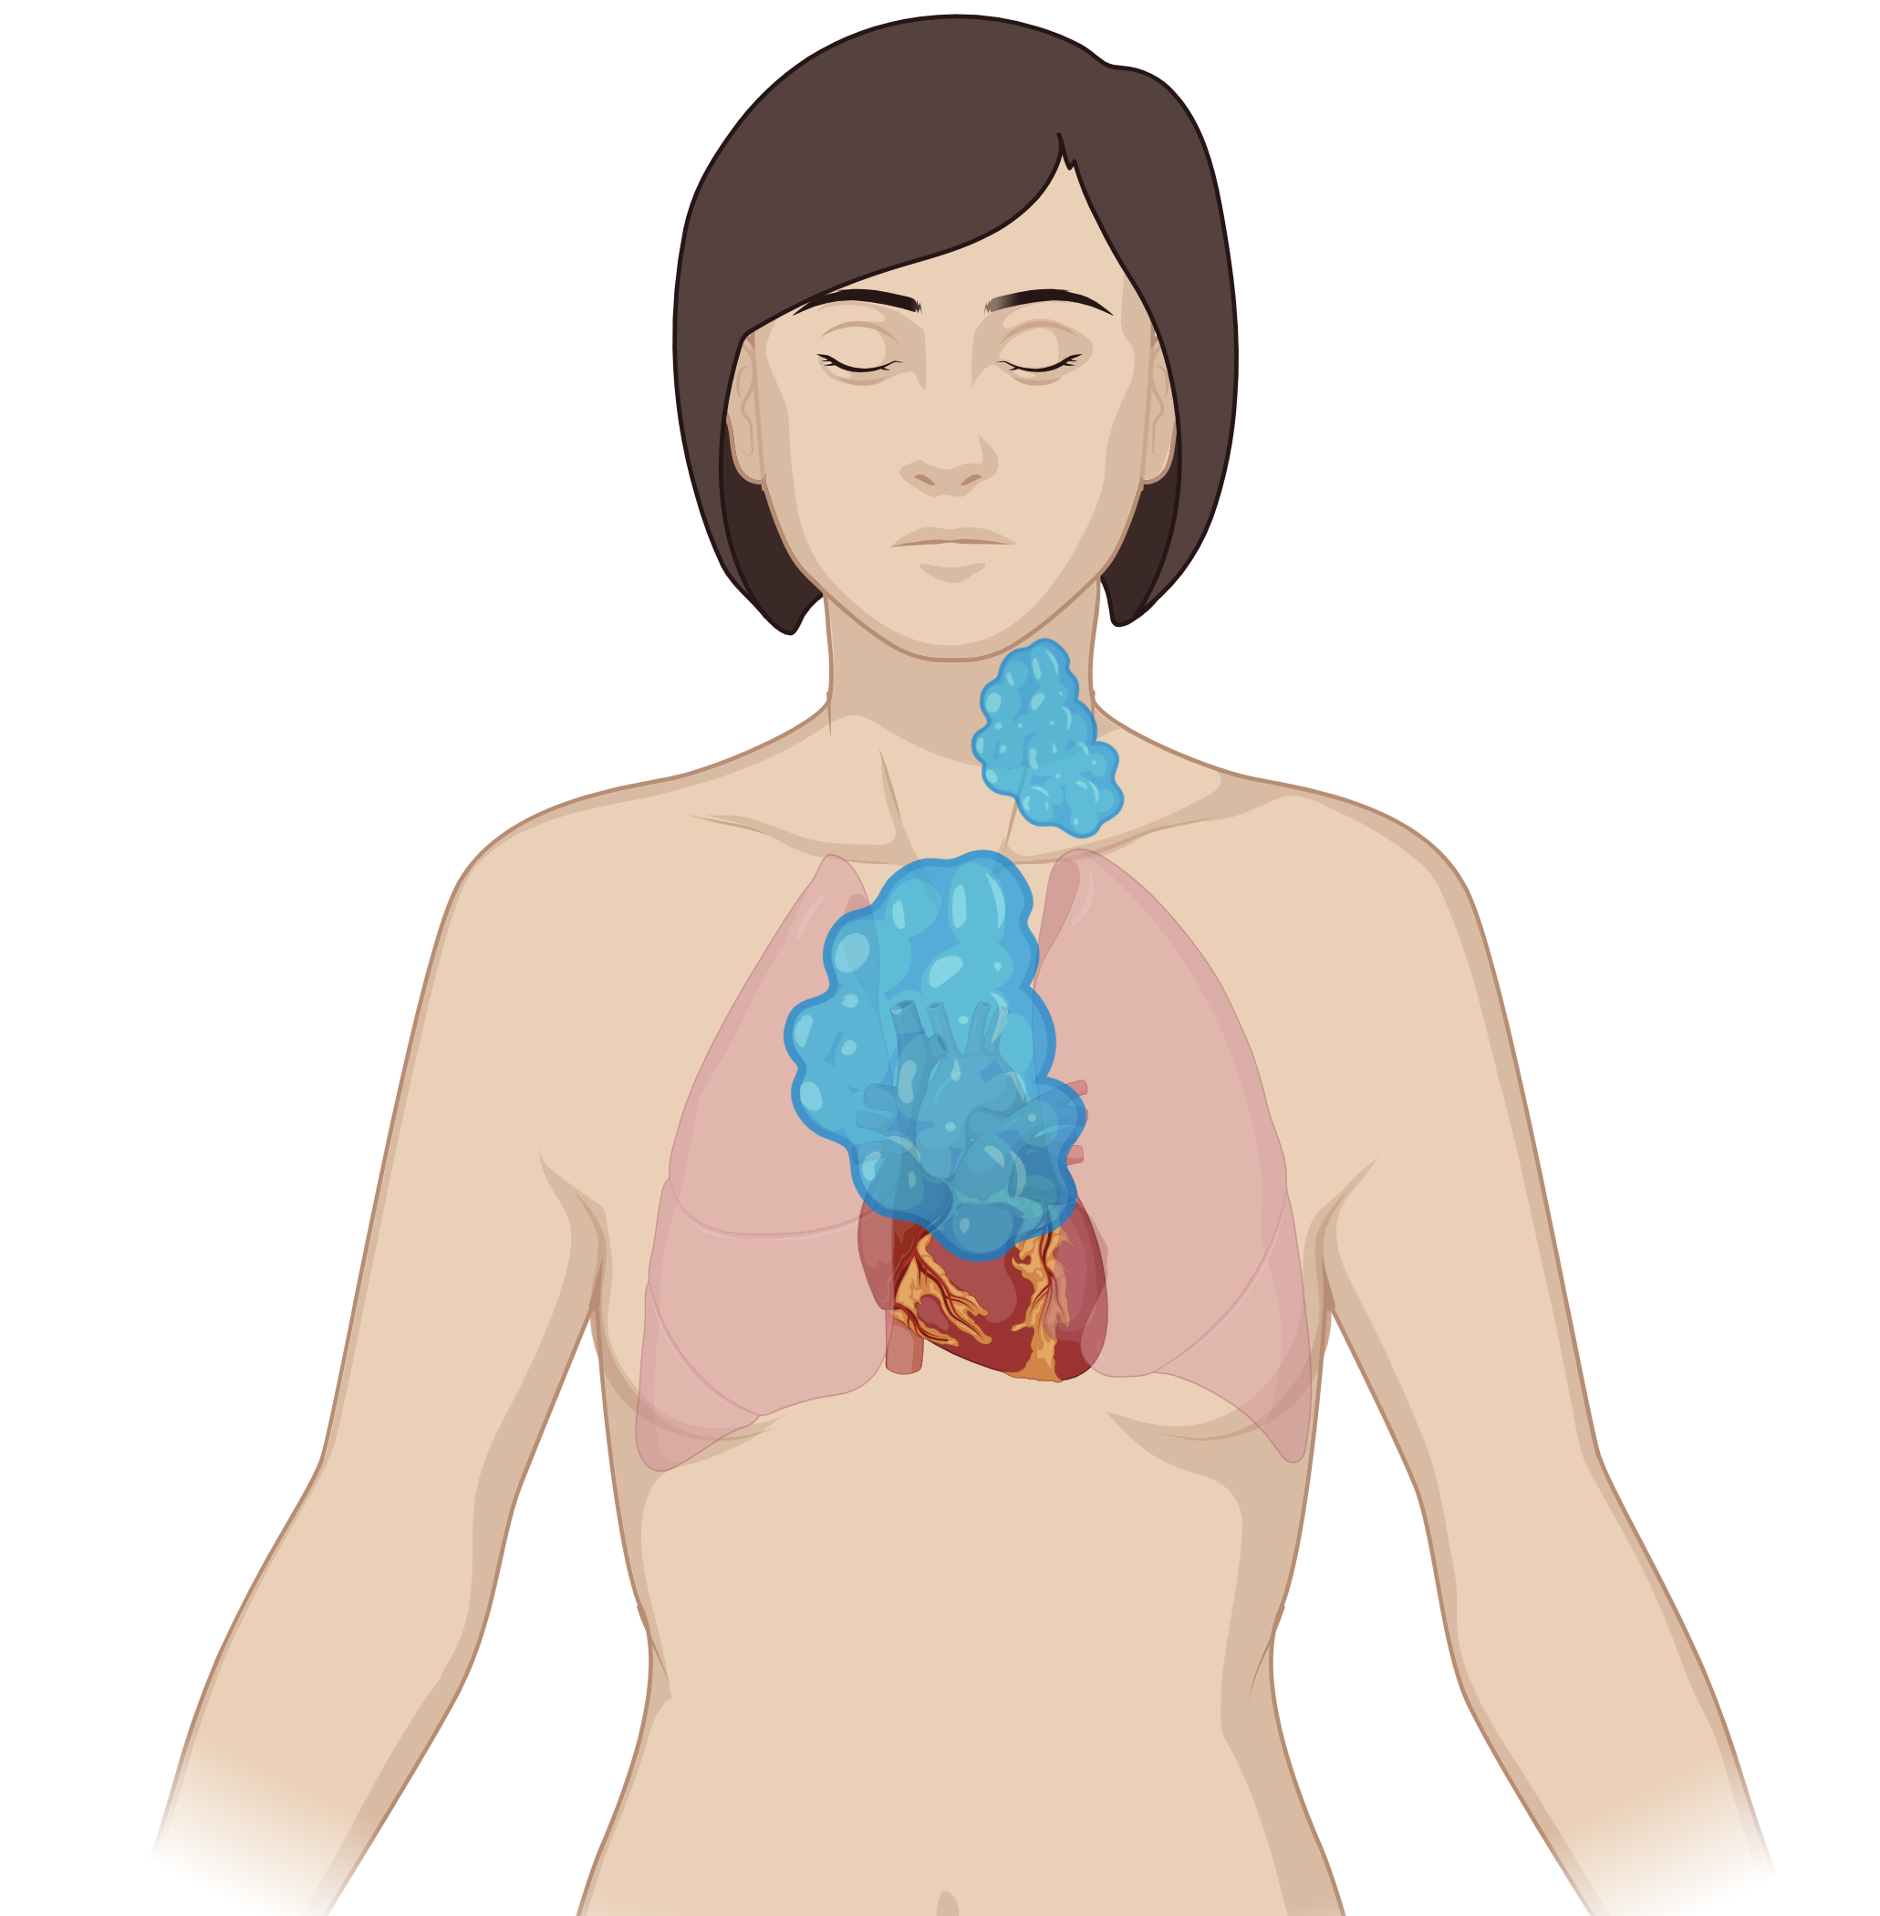
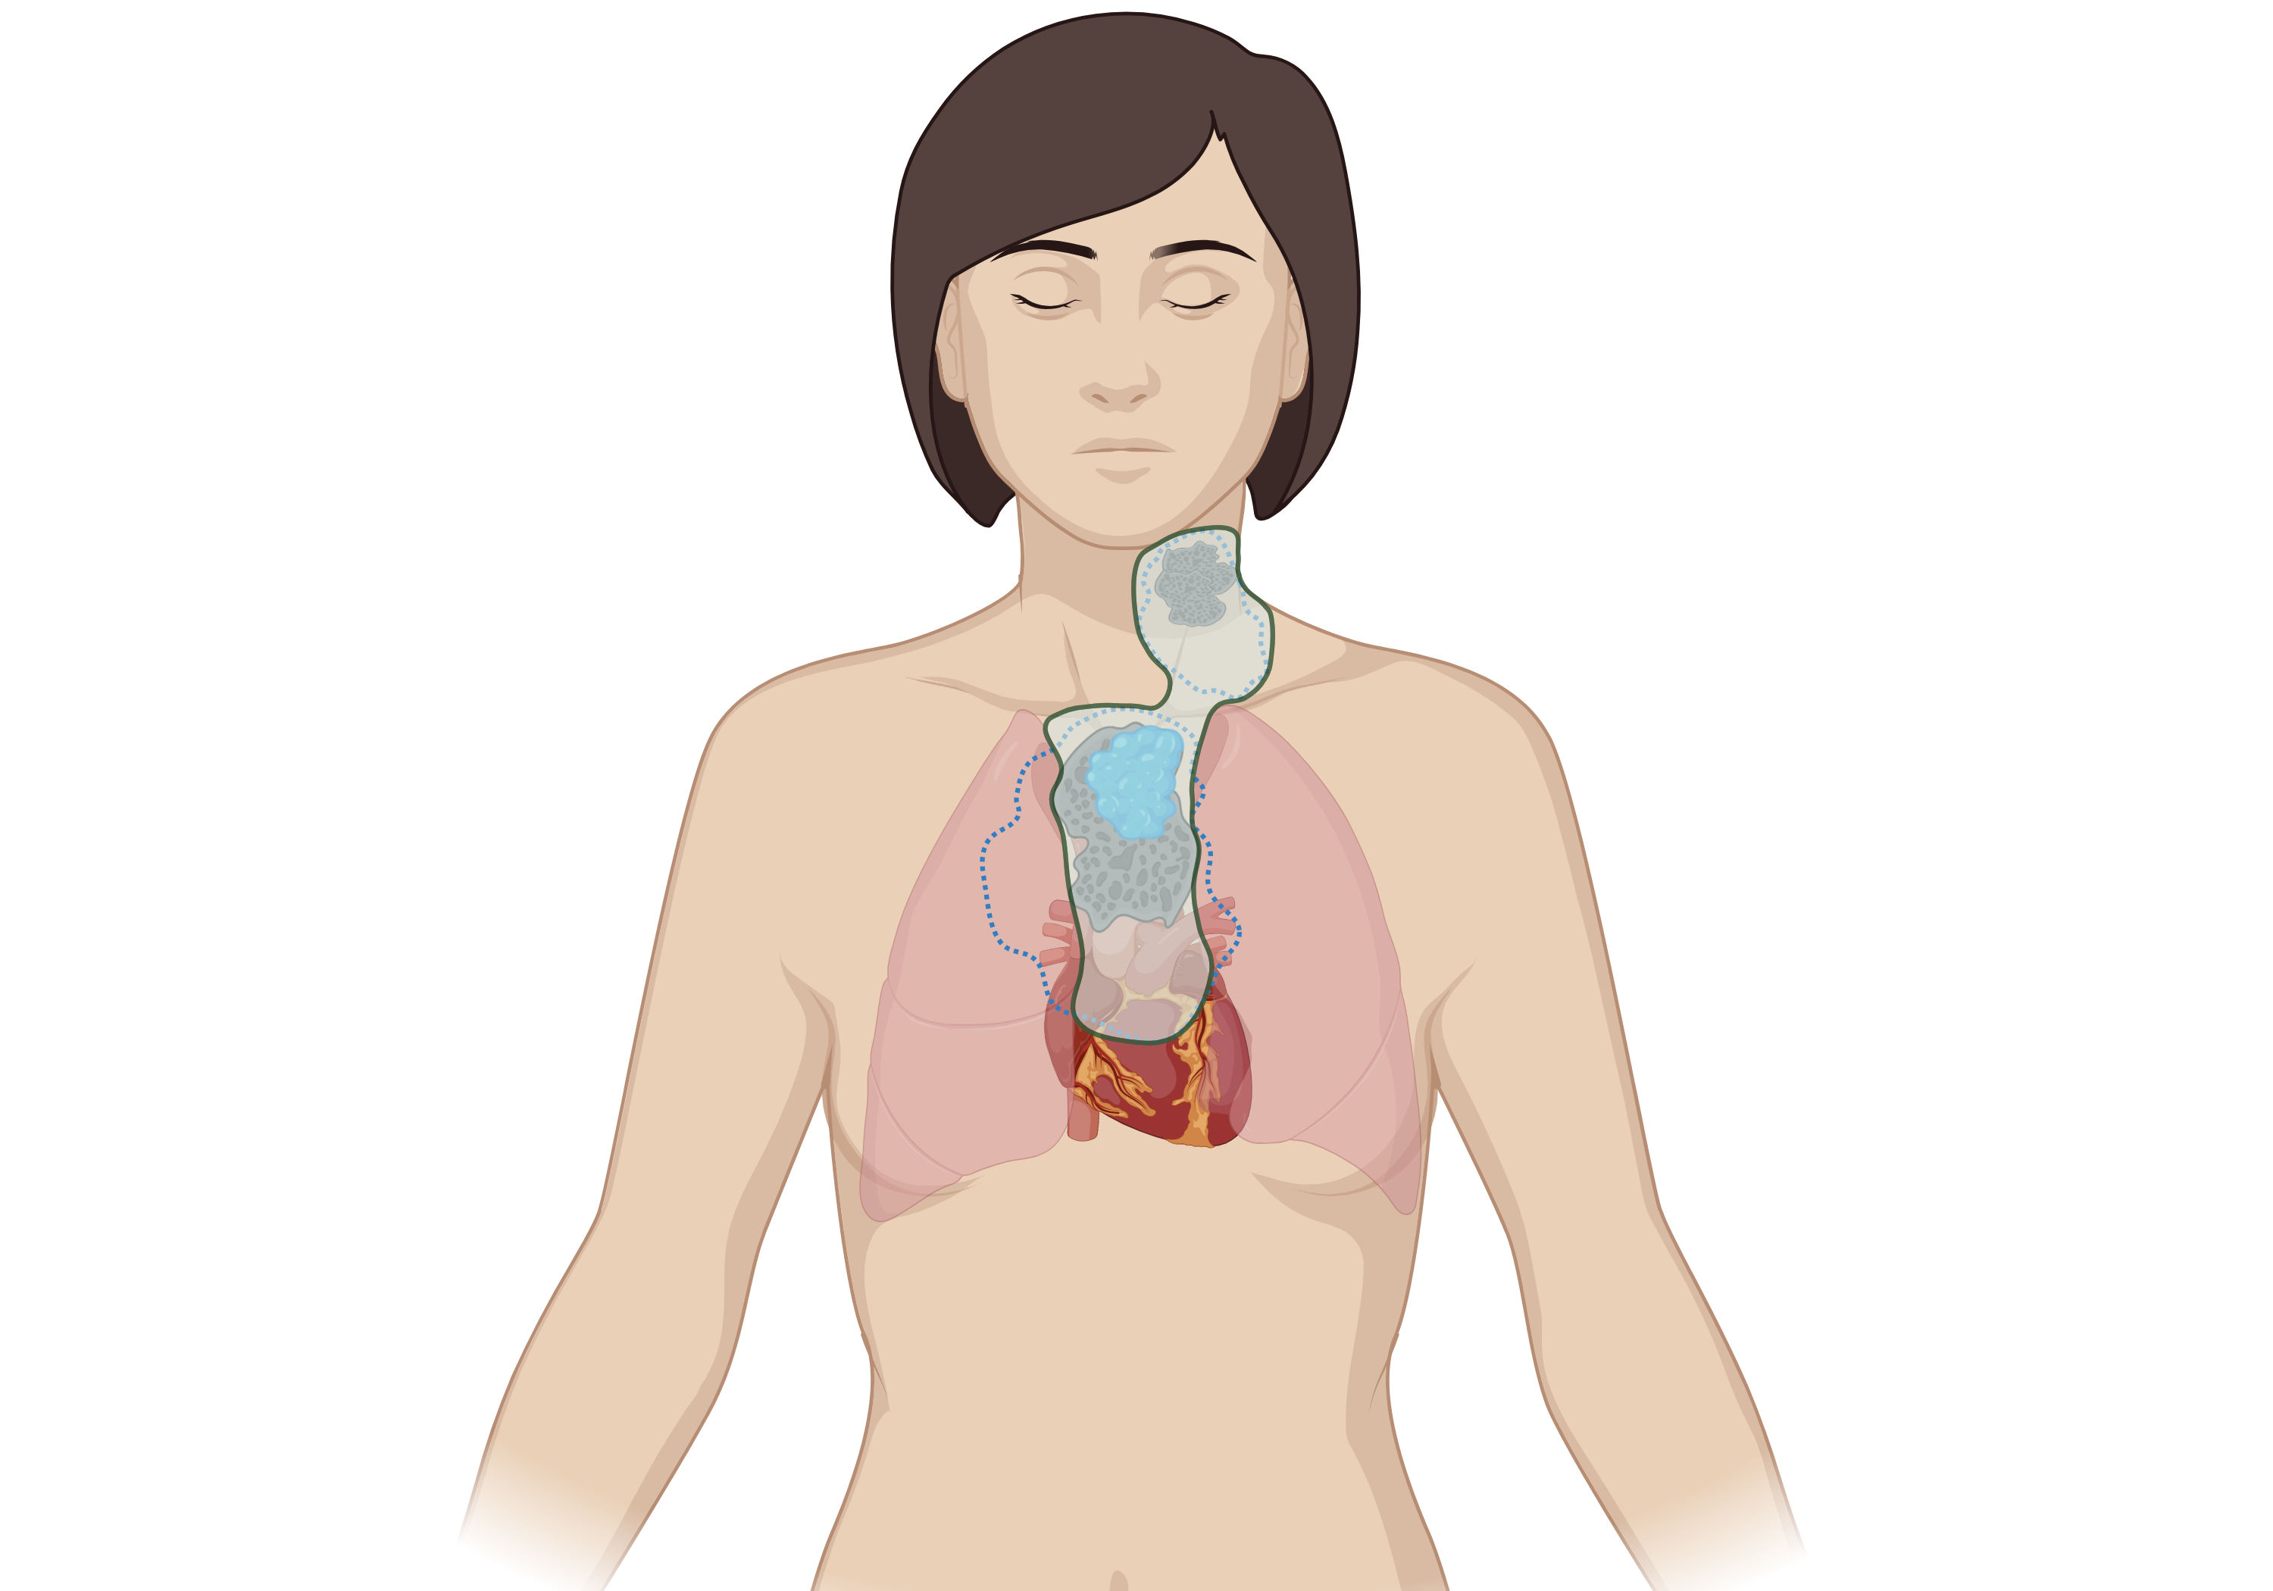
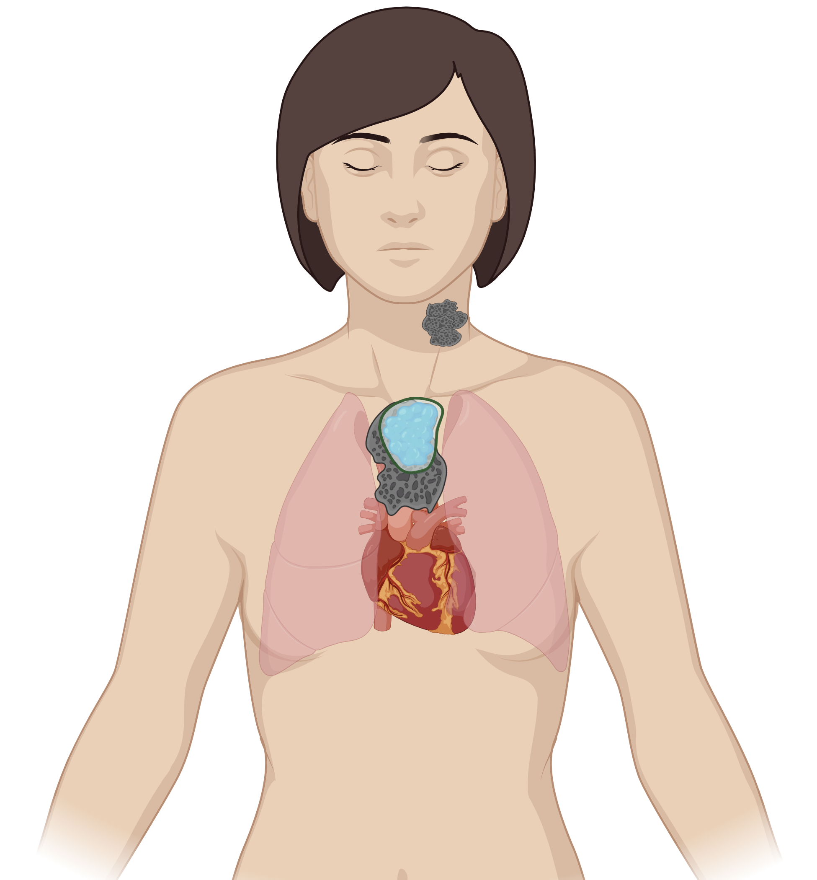
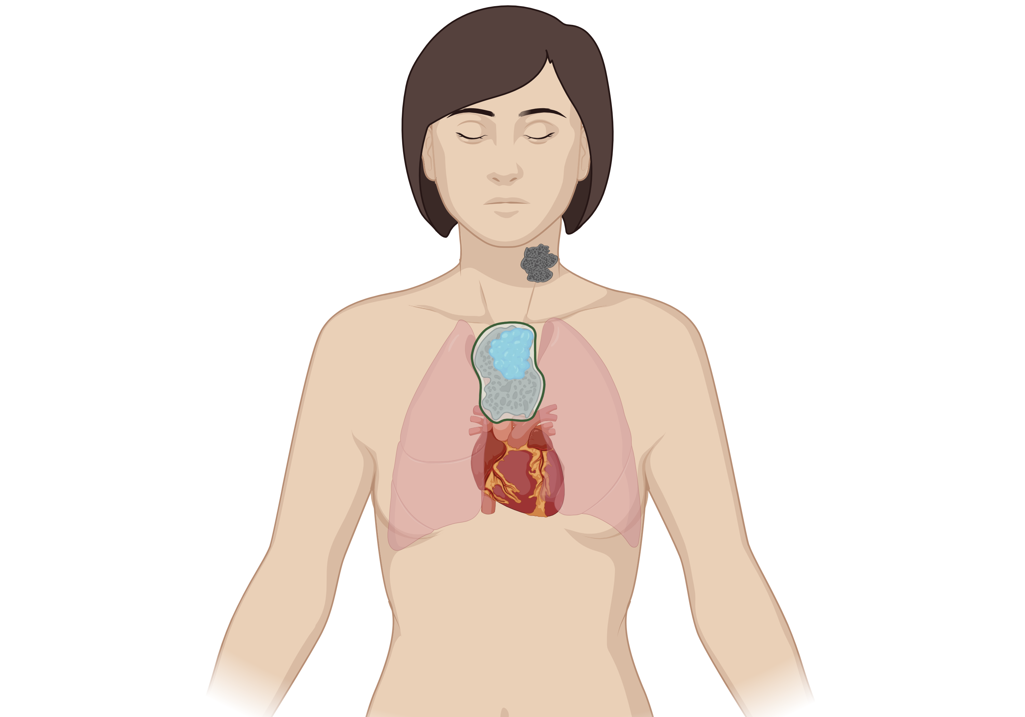
AHOD2131 Radiation Approach: Target Volume
Pre-chemo Disease
ISRT
Involved site RT +/- PET-directed boost
ISRT: LNs/tissues originally involved with HL, accounting for anatomic changes following chemotherapy
Volumes are individualized & typically smaller than historic IFRT fields
PET-directed boost: tissue in PMR at completion of systemic therapy
Deauville 4-5, even if LYRIC IR
PMR Site
Boost

Slide 4
AHOD2131 Radiation Approach: Dose
ISRT
pRSRT
SER → CMR | 30 Gy
SER → CMR <16 y/o Any age, OAR constraints would be exceeded with 30 Gy ISRT | 21 Gy | 9 Gy (SER)
SER → PMR | 30 Gy | 6-10 Gy (PMR)

Slide 5
AHOD2131 Radiation Approach: Dose
Why 30 Gy instead of 21 Gy?
21 Gy may be insufficient
AHOD0031: 90% of relapses occurred within the RT field ¹
AHOD0431: 80% of relapses in patients with SER/PR occurred within the RT field ²
In-field relapses are less common after 30-36 Gy
GHSG HD11: PFS is *not* non-inferior after 20 Gy vs. 30 Gy following ABVD x 4 ³
30-36 Gy is used on pediatric & adult trials after an incomplete metabolic response
S1826, AHOD1331
AHOD2131 is using RT for SERs, who have less chemoresponsive disease
However, 21 Gy ISRT + 9 Gy boost to SER sites is an option for patients with CMR on EST-PET who are
<16 years old
Any age, if normal tissue constraints cannot be achieved with 30 Gy ISRT
Dharmarajan, IJROBP 2015
Parekh, Blood 2022
Eich, JCO 2010

Slide 6
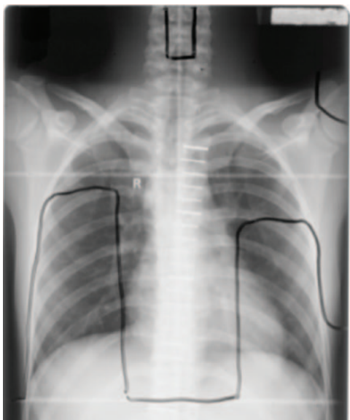
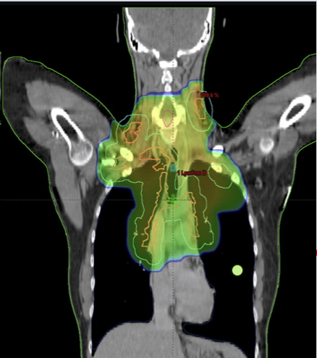
AHOD2131 Radiation Approach: Technique
Advanced RT techniques are allowed (IMRT, VMAT, proton therapy)
Highly conformal
Minimize dose to normal tissues compared to historic 2D and 3D techniques
Motion assessment/reduction is encouraged (ex DIBH)
Historic 2D
IMRT with DIBH
Protons
Cutter et al. JNCI 2015
Specht et al. IJROBP 2014
Hoppe et al. IJROBP 2014

Slide 7
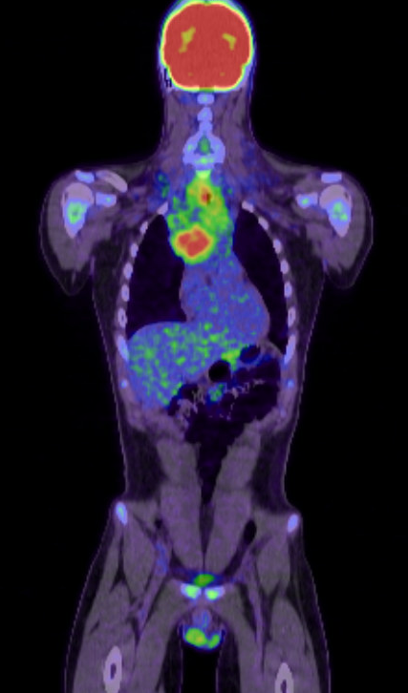
AHOD2131 Case #1
25 y/o man with stage IIA classic HL
PET2: Deauville 4 (SER)
EST-PET: Deauville 2 (CMR)
ISRT: 30 Gy in 15 fractions

Slide 8
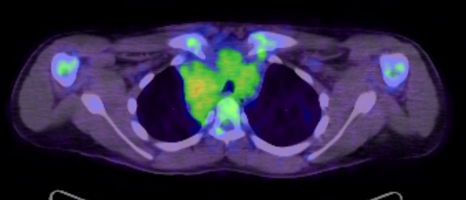
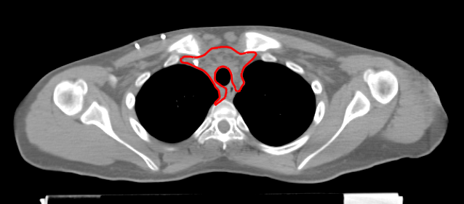
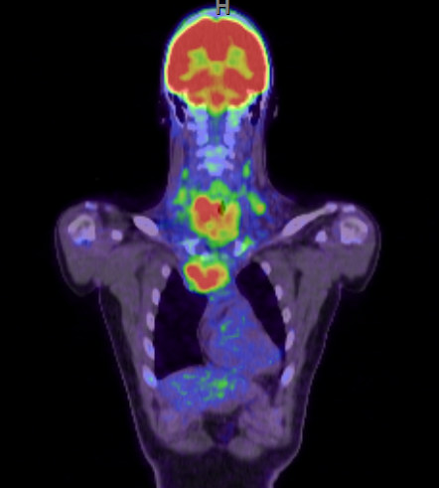
Baseline PET
CTVisrt
Notes:
The CTV encompasses the original lymphoma volume but does not include normal structures that were displaced by, but were never involved by, lymphoma, such as lungs. Here you can see that lung tissue was displaced by the mediastinal tumor, but the lung tissue has returned to its normal position after the tumor has responded to chemotherapy. So it is not necessary to include that area of lung tissue in the CTV.

Slide 9
IMRT Plan Using DIBH & Butterfly Arrangement*
* Voong et al. Radiat Oncol. 2014 Apr 15:9:94

Slide 10
AHOD2131 Case #2
45 y/o woman with stage IIA bulky classic HL
PET2: Deauville 4 (SER)
EST-PET: Deauville 4 (PMR)
ISRT: 30 Gy in 15 fractions
Sequential boost to area with a PMR at completion of systemic therapy: 8 Gy in 4 fractions

Slide 11
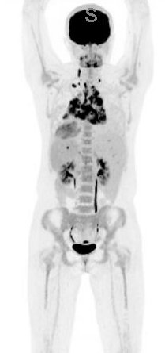
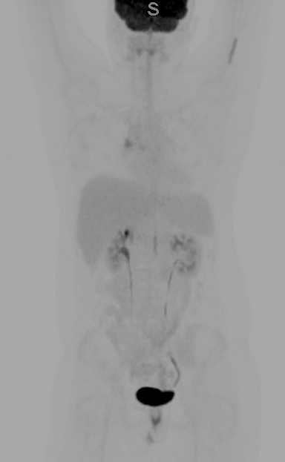
Baseline PET
PET2: 5-point score 4
EST-PET: 5-point score 4

Slide 12
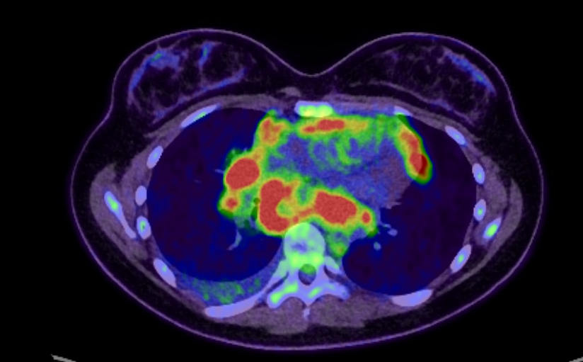
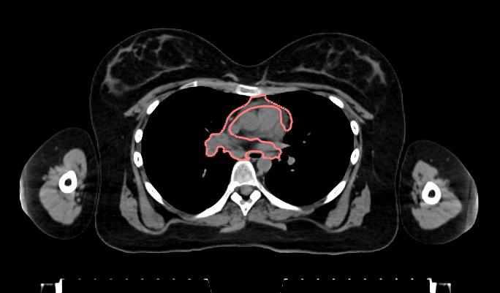
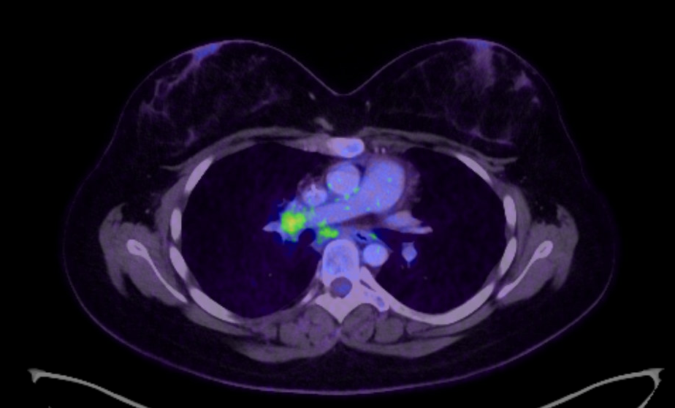
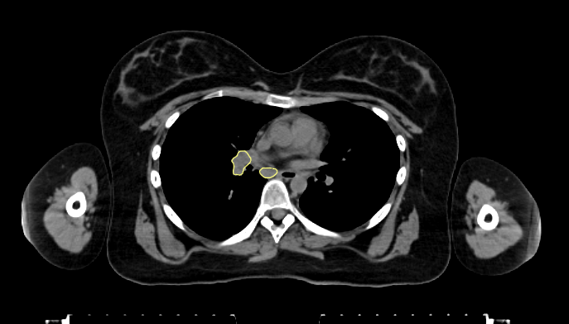
Baseline PET
CTVisrt
EST-PET
CTVpr
Notes:
A breath hold technique was used. 3 breath hold scans were obtained at simulation to ensure reproducibility.
There was no variability in anatomy between breath hold scans.
Therefore, no ITV was needed.

Slide 13
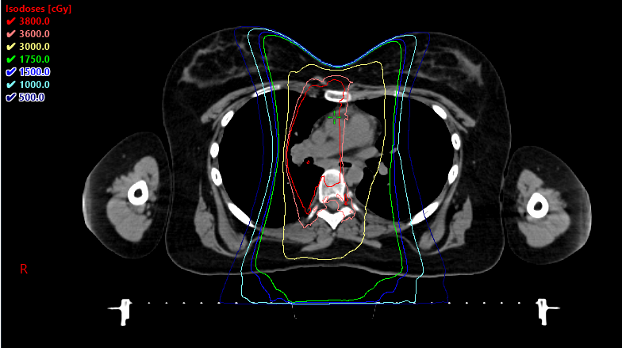
IMRT Plan Using DIBH & Butterfly Arrangement*
* Voong et al. Radiat Oncol. 2014 Apr 15:9:94

Slide 14
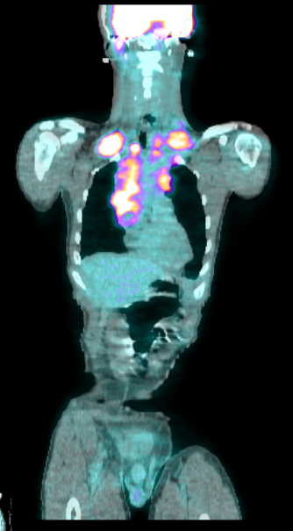
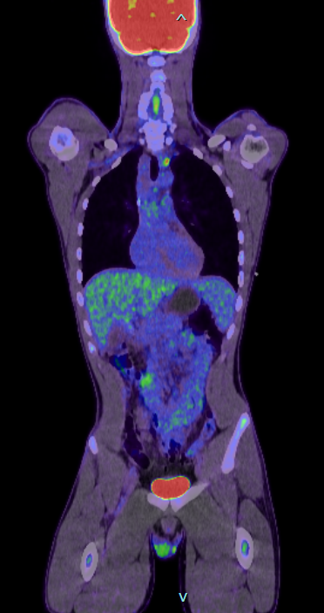
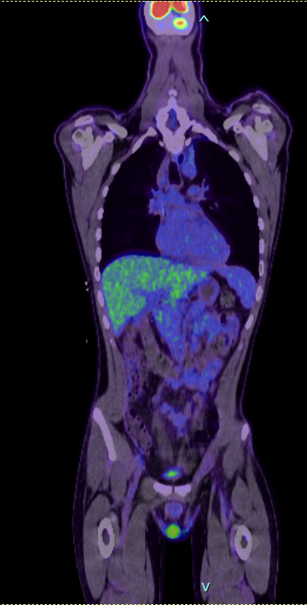
AHOD2131 Case #3
Baseline
PET2
EST-PET
14 y/o boy with stage II cHL
PET2: Deauville 4 (SER)
EST-PET: Deauville 3 (CMR)
In CMR & <16 y/o →
ISRT: 21 Gy/14 fractions
Boost to SER site: 9 Gy/6 fractions
DS4
Notes:
AN 1931109
9796 202 615

Slide 15
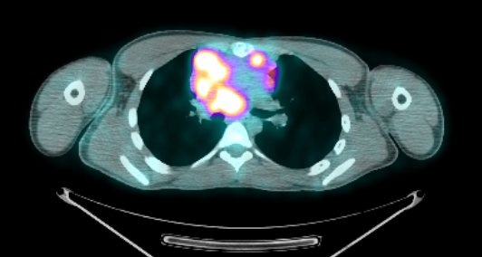
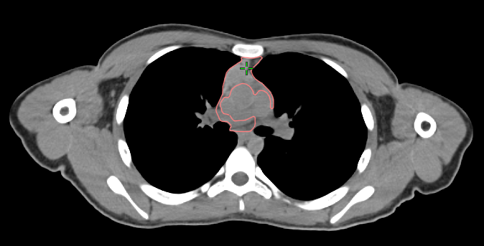
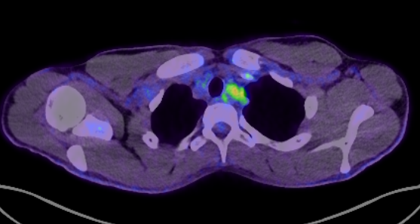
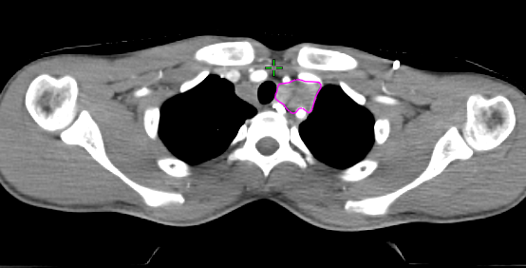
Baseline PET
CTVisrt (21Gy)
PET2
CTVser (9Gy boost)
Deauville 4

Slide 16
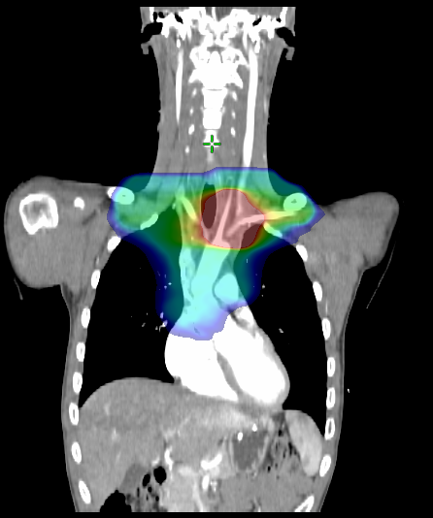
IMRT Plan Using DIBH & Butterfly Arrangement*
* Voong et al. Radiat Oncol. 2014 Apr 15:9:94

Slide 17
Case 4
30 y/o F with stage IIA Hodgkin lymphoma
PET2: Deauville 4
EST-PET: Deauville 4
ISRT: 3000 cGy in 15 fractions
Sequential boost to area with a PR at completion of systemic therapy: 600 cGy in 3 fractions

Slide 18
Contours
Orange
CTVisrt – 30 Gy
All initial sites
Magenta
CTVpr – 9 Gy
Partially responding site (EST-PET+)
Pre-chemo PET
EST-PET

Slide 19
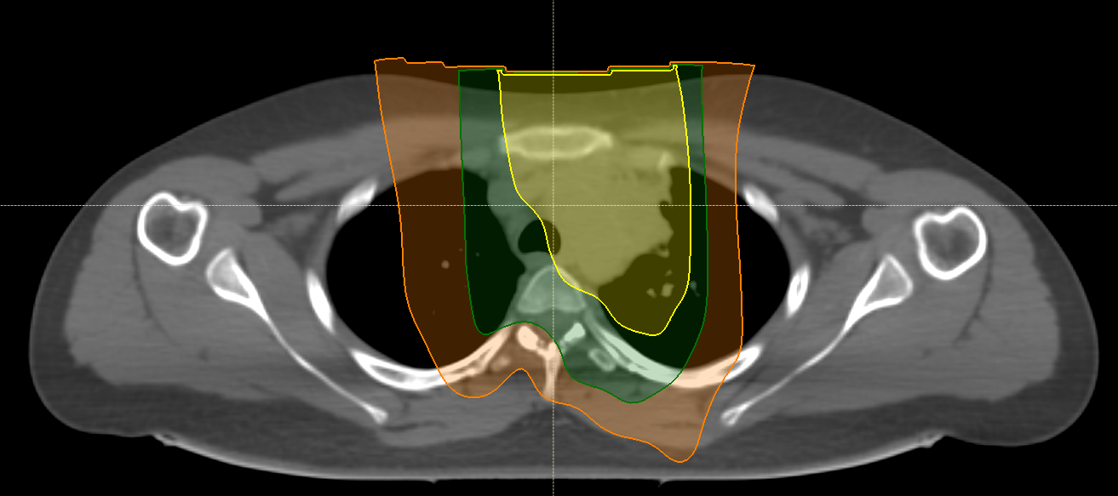
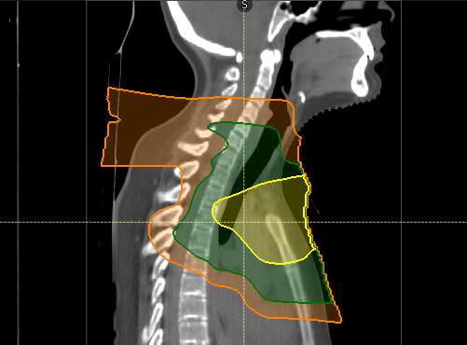
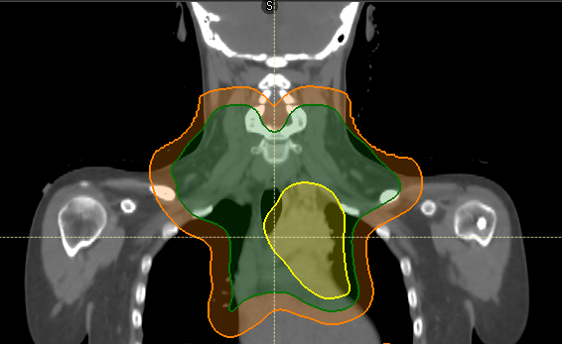
Dose (% of prescription): Yellow: 95% of CTVpr Green: 95% of CTVisrt Orange: 10% of CTVisrt

Slide 20
Case 5
11 y/o boy with stage IIB classical Hodgkin lymphoma
PET2: Deauville 4
EST-PET: Deauville 3
In CR after chemo & under 15 y/o → 21 Gy ISRT + 9 Gy boost to the slowly responding site
ISRT: 2100cGy/14 fractions
Boost to PET SER disease: 900cGy/6 fractions

Slide 21
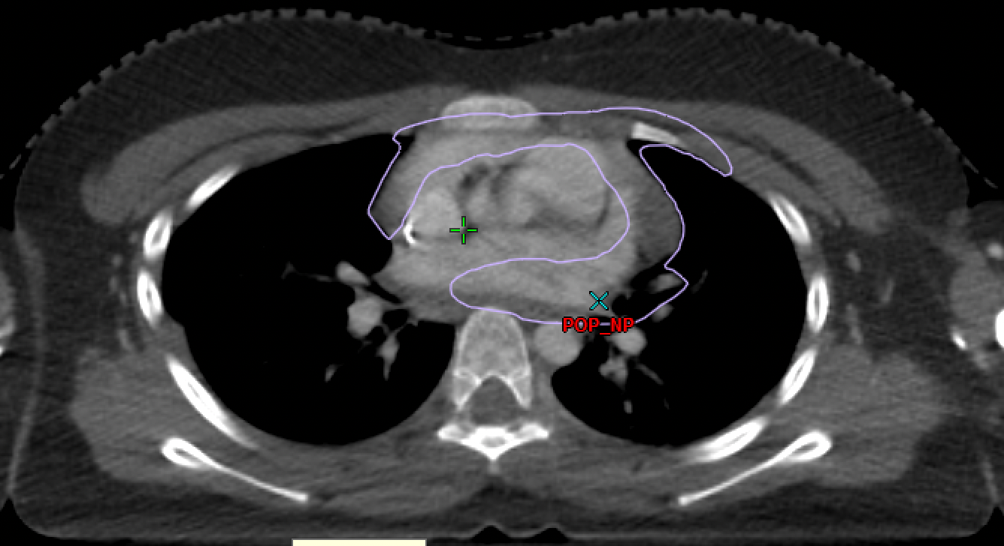
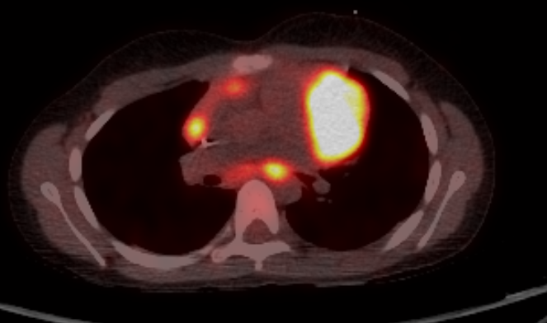
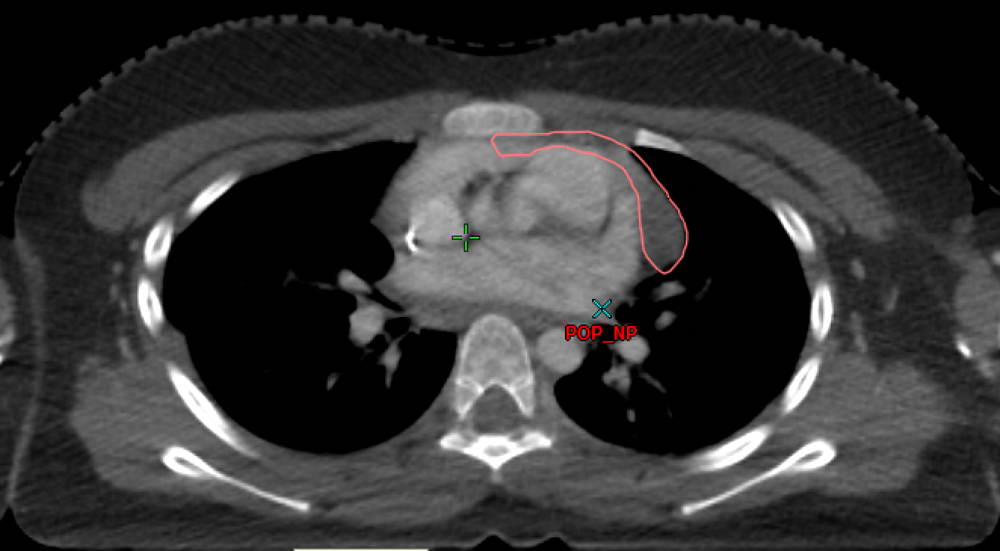
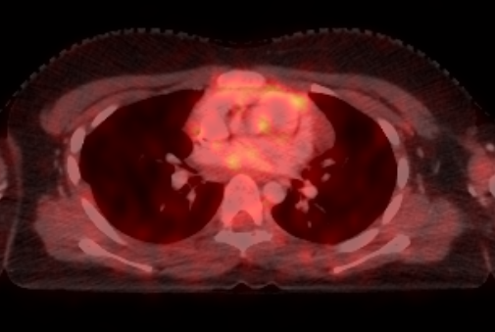
CTV 21Gy
Staging PET
CTV 9Gy Boost
PET2

Slide 22
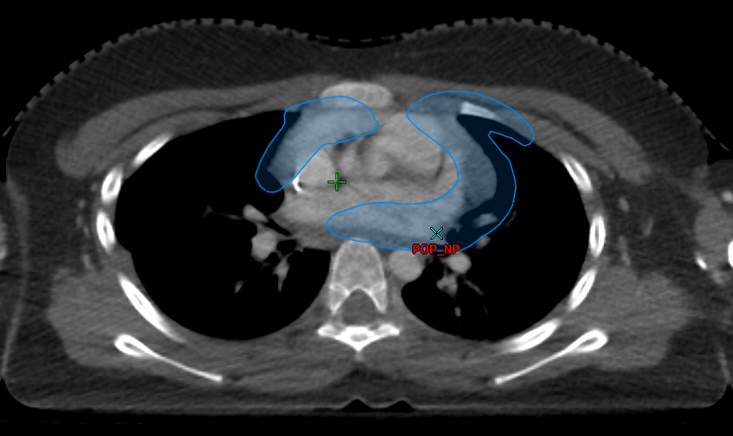
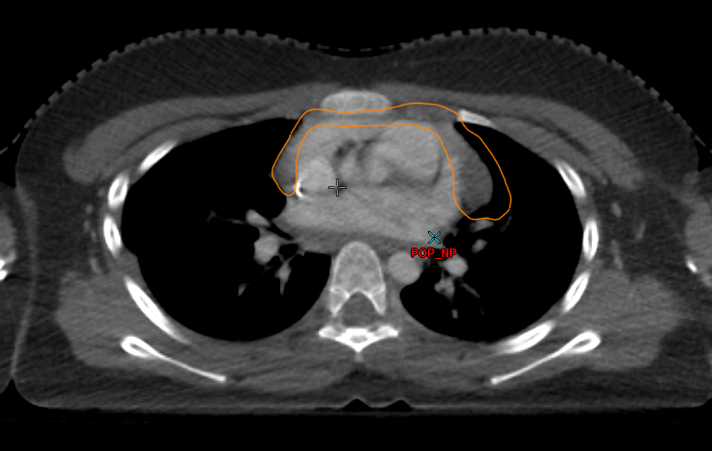
ITV 21Gy
Staging PET
ITV 9Gy Boost
PET2

Slide 23
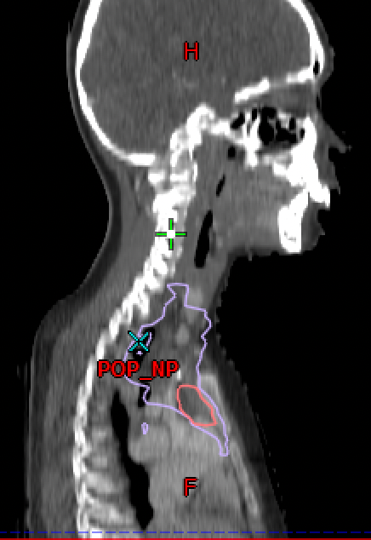
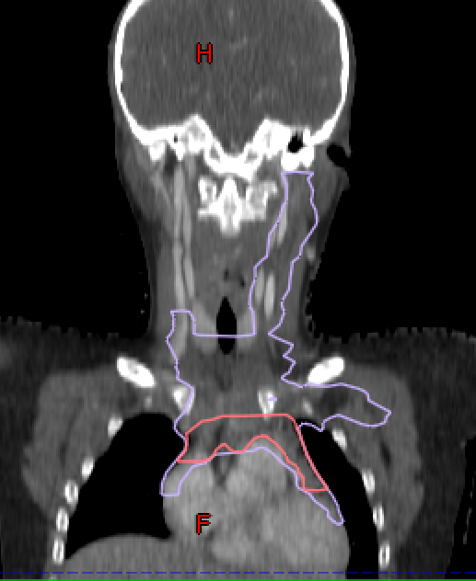
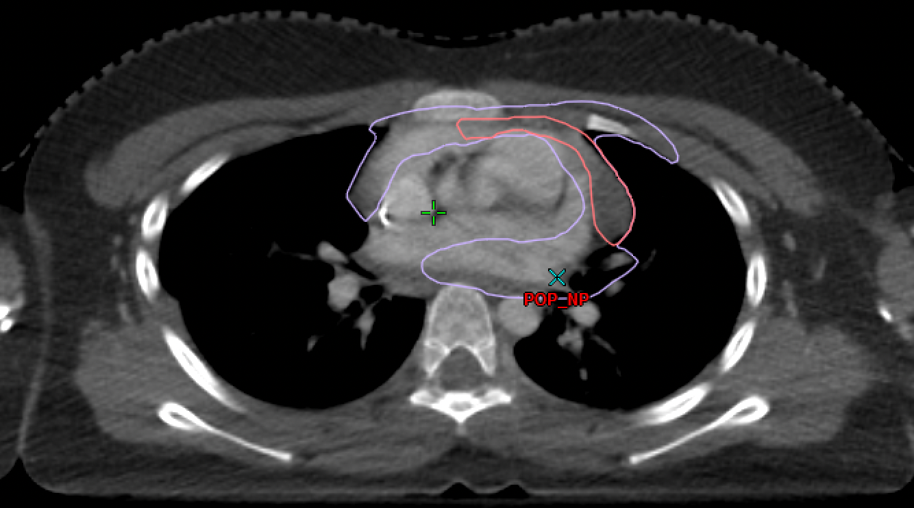
Purple = CTVisrt (21Gy)
Pink= CTVser (9Gy)

Slide 24
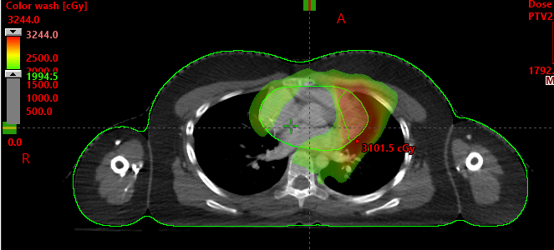
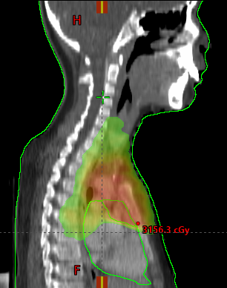
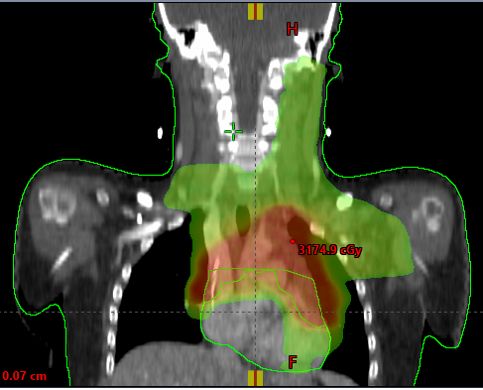

Slide 25
AHOD2131 Radiation Approach: Central Review
All contours & RT plans undergo central review by the study team before the patient is treated
Early referral to RO is highly recommended to allow time for treatment planning, submission for central review, contour/plan revision if required, and final approval
Goal: rigorous, real-time central review, building upon QA performed on prior studies of early-stage HL
EORTC H10: retrospective QA, representative sample of INRT plans, no PET fusion
GHSG HD16/17: retrospective QA, all INRT plans & a representative sample of IFRT plans, no PET fusion
AHOD0031: prospective QA, all plans prior to treatment, APPA fields, no PET fusion

Slide 26
Sim CT + contours + PET CT scans
Treating RO notified of changes needed
Deviation
-Read institutional & central review of PETs
-Fuse sim CT + PETs
-Review target & OAR contours
Central Review Team (2-4 ROs)
IROC-RI
Review RT plan, & doses to
OARs & targets
Treating RO notified OK to treat
Per protocol

Slide 27
AHOD2131 Radiation Approach: Central Review
Written feedback with screenshots provided to treating RO regarding the contours & RT plan
Average time from receiving RT data at IROC-RI to sending feedback to investigator: 1.8 days
Thank you, IROC-RI team!
Deviations (revision required):
Contours: disease missed
Plan: dose to targets or OARs defined as “Deviation Unacceptable” in protocol
Variation acceptable (revision optional):
Contours: targets over-contoured
Plan: doses to targets or OARs defined as “Variation Acceptable” in protocol

Slide 28
Challenge #1: Fusion Confusion
Contoured
Intended to contour
Contoured
Intended to contour
PET-directed boost for node with PMR
Sim performed with arms up, PET with arms down
Contoured superior LN, meant to contour inferior LN

Slide 29
Challenge #1: Fusion Confusion
Differences in body positioning for PET and sim CT complicate interpretation of registered images
Arms up vs. down
Differences in neck flexion
Suggestions:
Try to sim with the same body position that was used for the PET, if it is acceptable for RT
A “mental fusion” may be valuable
Notes:
AN 1931109
9796 202 615

Slide 30
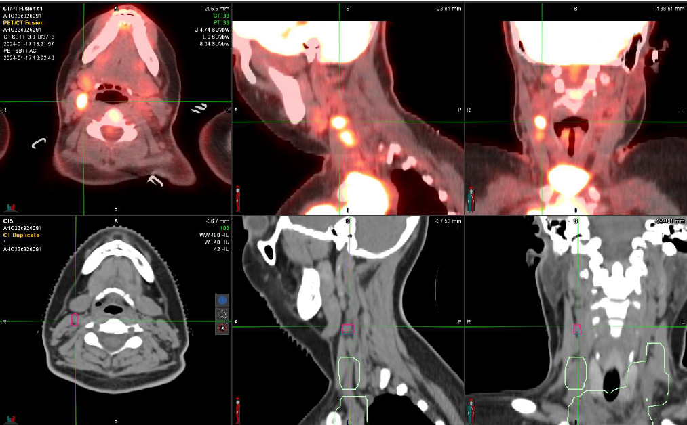
Challenge #2: Site Omission
Omitted from CTVisrt
Omitted from CTVisrt
CTVisrt
Initially involved nodes in R neck extended more superiorly than CTVisrt

Slide 31
Challenge #2: Site Omission
All sites of initial involvement should be included in CTVisrt, even if they respond completely to systemic therapy
There might not be an obvious residual abnormality on the sim CT
Suggestions:
Carefully review baseline imaging & reports
Review PET central review findings in case of discrepancies between institutional & central review

Slide 32
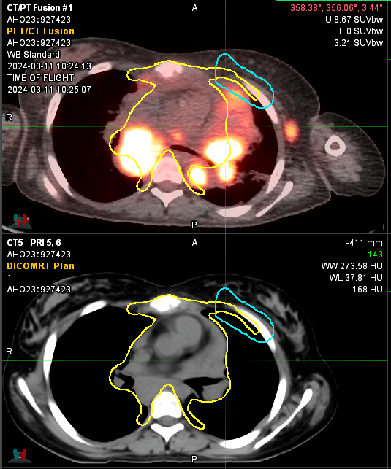
Challenge #3: Adjusting for Anatomic Changes
Contoured as CTVisrt
Contoured as CTVisrt
Bulky mediastinal mass contacted, but did not invade, anterior chest wall → chest wall does not need to be included in CTV

Slide 33
Challenge #3: Adjusting for Anatomic Changes
CTV
Should account for anatomic changes that occur with chemotherapy
Should include tissues that were infiltrated by lymphoma at diagnosis
Should not include tissues that were only contacted/displaced
Suggestions:
Carefully review imaging & reports
Consider whether normal tissues were infiltrated (include in CTV) or contacted/displaced (exclude from CTV)

Slide 34
Final Thoughts
AHOD2131
Employs a modern, individualized RT approach
Prescribes RT for a small subset of patients with the greatest risk of relapse
Incorporates rigorous pre-treatment RT review
Please contact the AHOD2131 RO investigators if you have questions:
Brad Hoppe: hoppe.bradford@mayo.edu
Andrea Lo: andrea.lo@bccancer.bc.ca
Ray Mailhot: rbmailhot@floridaproton.org
David Hodgson: david.hodgson@uhn.ca
Sarah Milgrom: sarah.milgrom@CUAnschutz.edu

